Slide 1






Presentation for G9-3 (C915) – Project 2
By Emiljano Bodaj, Nabila Ahmed, Jason Brandwein, Juhao Chen, Lin Chen, Danny Mancheno

Slide 2
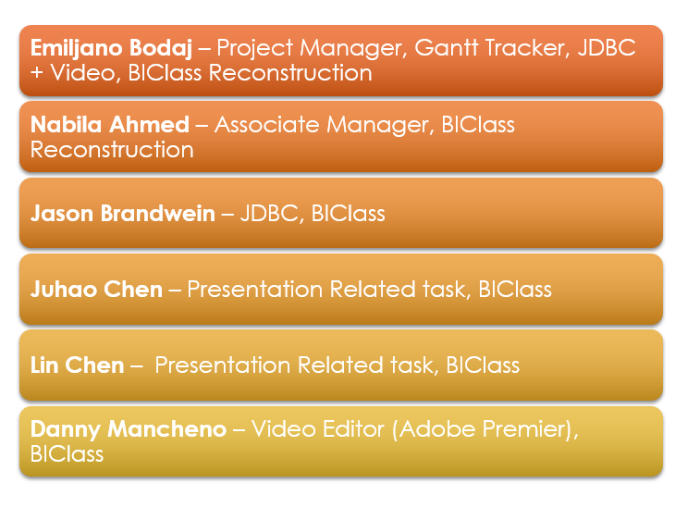
Group Members Task
Emiljano Bodaj – Project Manager, Gantt Tracker, JDBC + Video, BIClass Reconstruction
Nabila Ahmed – Associate Manager, BIClass Reconstruction
Jason Brandwein – JDBC, BIClass
Juhao Chen – Presentation Related task, BIClass
Lin Chen – Presentation Related task, BIClass
Danny Mancheno – Video Editor (Adobe Premier), BIClass

Slide 3

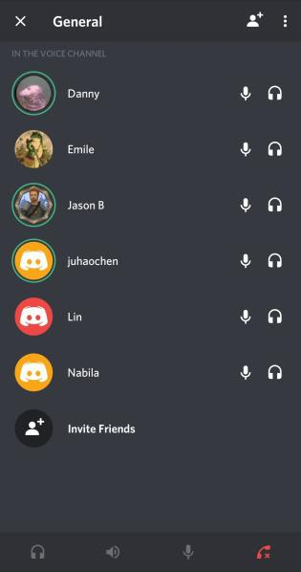
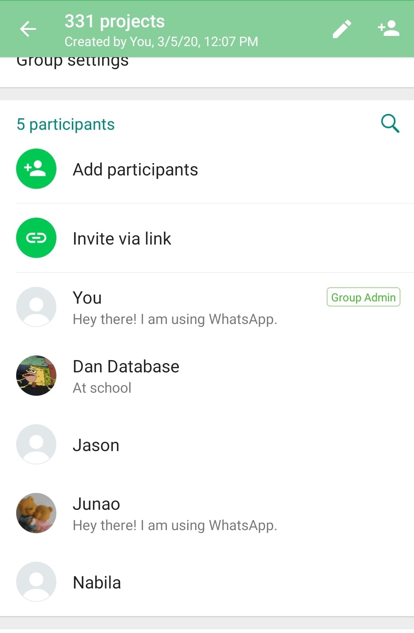
Group Meetings
Group Meeting One
Agenda:
Divide the work among all group members.
Ask the group members to plan out their to-do list and have it ready by next meeting
Set a date for the next group meeting
Set up google group and a drive so everyone can submit their work.
Interpreting the project’s specifications
Group Meeting Two
Agenda:
Go over the members to-do list and the team’s Gantt Tracker.
Answer any questions a member might have regarding the project’s requirements and objective.
Set a date for the next group meeting via Zoom or Discord.
Average meeting was approximately 30-40 minutes.

Slide 4
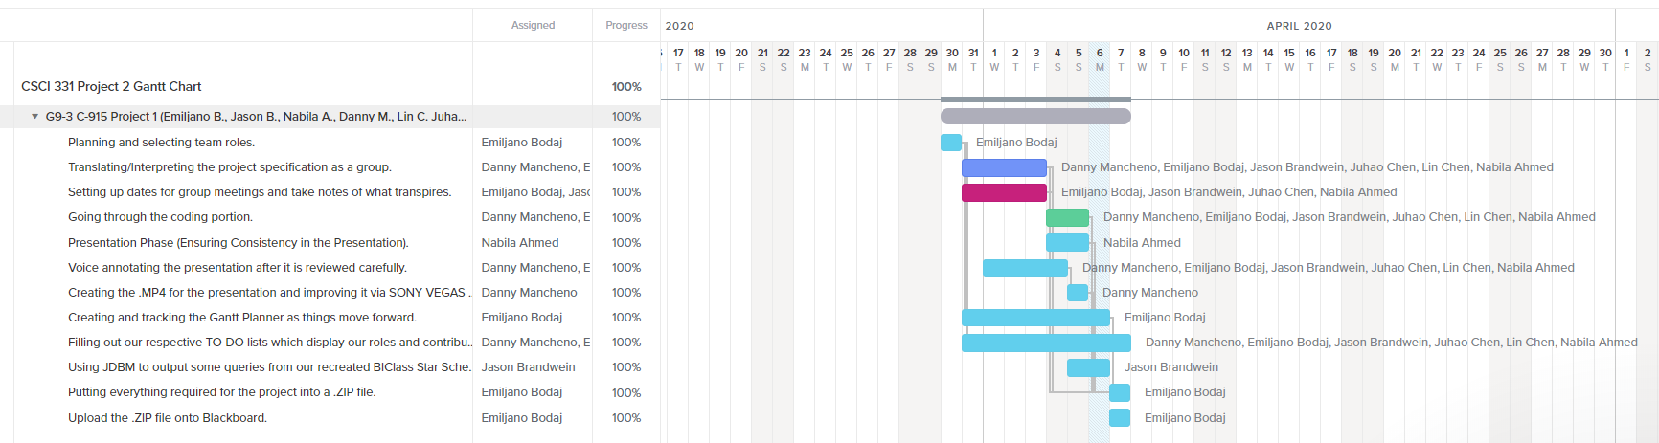
Finalized Project 2 Gantt tracker (G3-9)
Pre-Extension

Slide 5
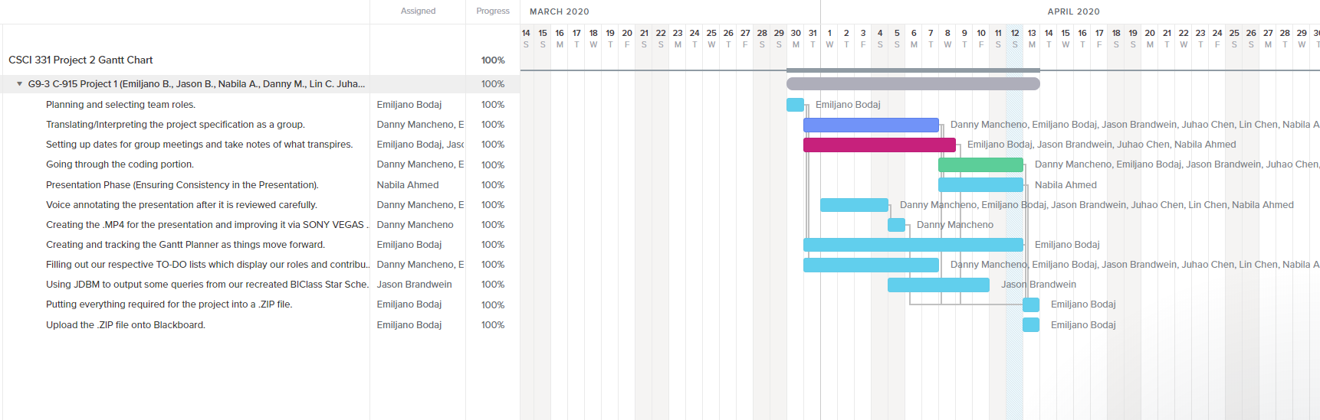
Finalized Project 2 Gantt tracker (G3-9)
Post-Extension

Slide 6
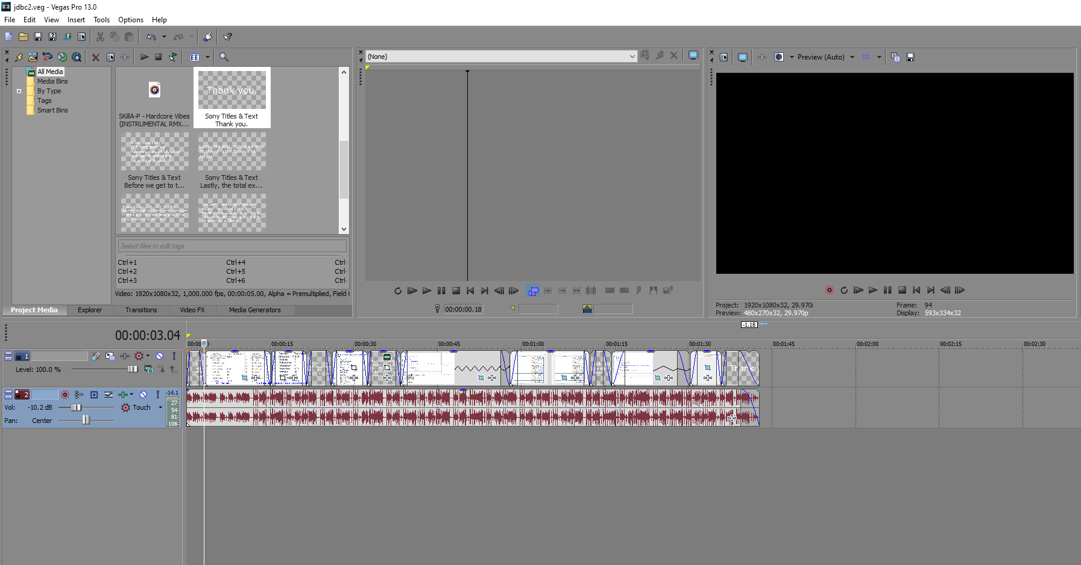


For Video Editing
Sony Vegas (Emiljano Bodaj) and Adobe Premiere (Danny Mancheno) were utilized for
the project. These services were used specifically for the JDBC video and presentation
.MP4, respectfully.

Slide 7
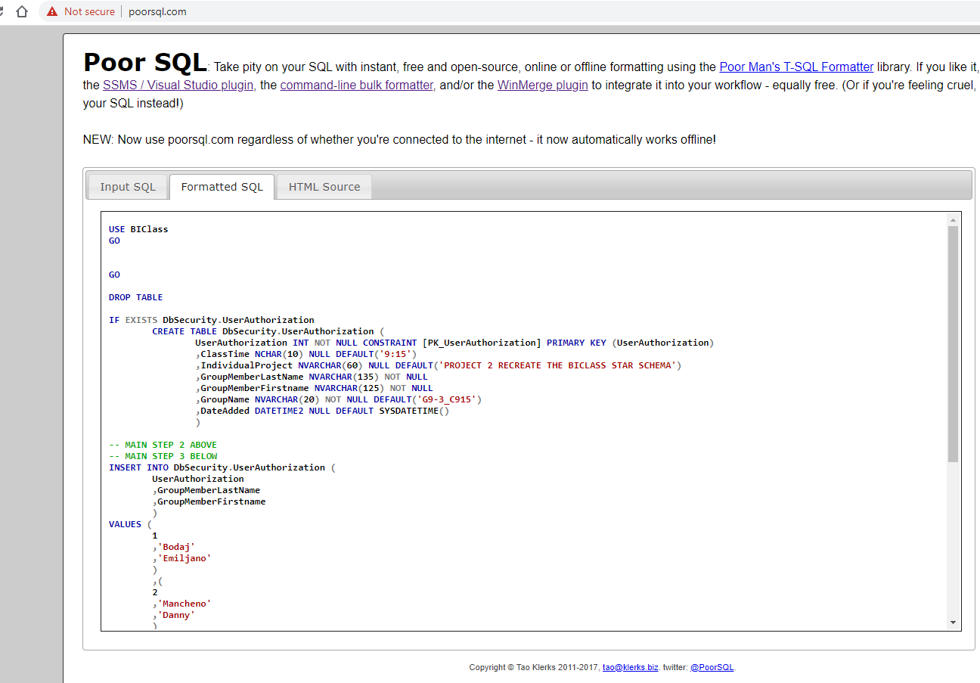
POORSQL.COM is once again utilized for proper formatting

Slide 8
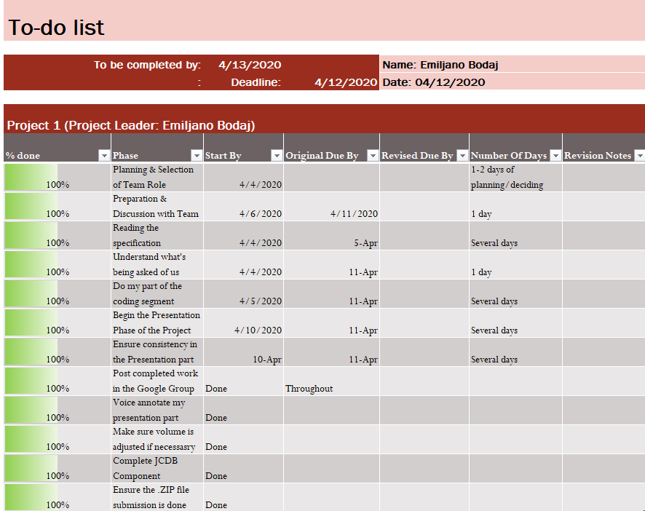
To-do List for Emiljano Bodaj

Slide 9
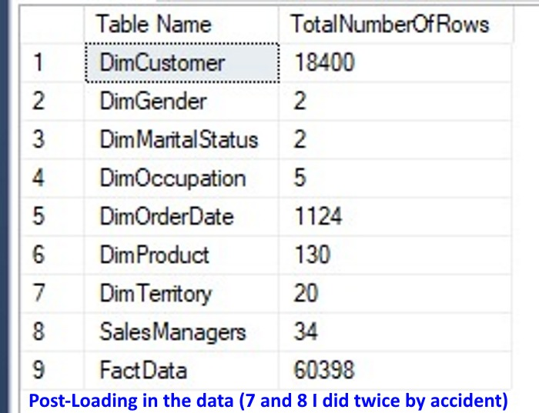
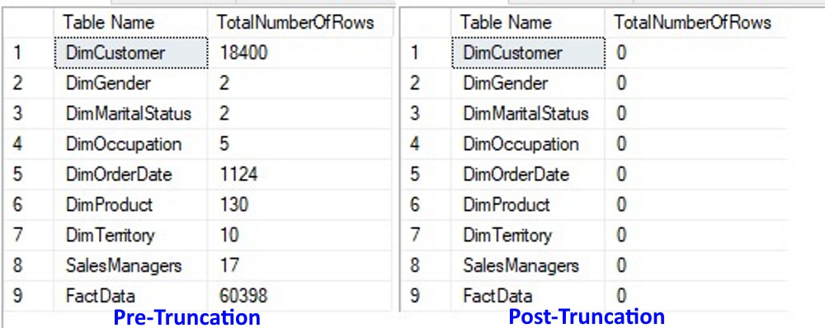
Delving into the coding portion (Recreation of the BIClass Database)
Some Preamble Before the Actual Code
Checking the amount of rows in each table before they were tampered with, after the old tables have been
truncated, and then after they were loaded with the contents of the FileUpload.OriginallyLoadedData
table + sequences (for the columns that aren’t present in that table, such as ColumnKey).

Slide 10
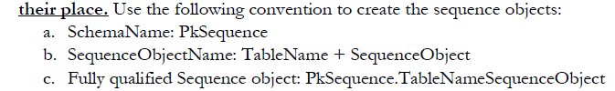
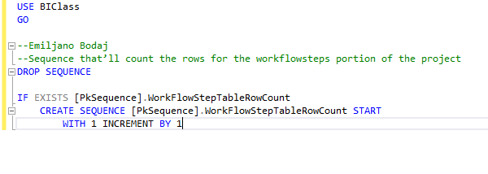
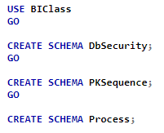
Creating the sequence PkSequence.WorkFlowStepsRowCount to number the steps in the
Process.WorkFlowSteps table. It will also be used in other ways throughout the project.
Creating the required
Schemas for the Project

Slide 11
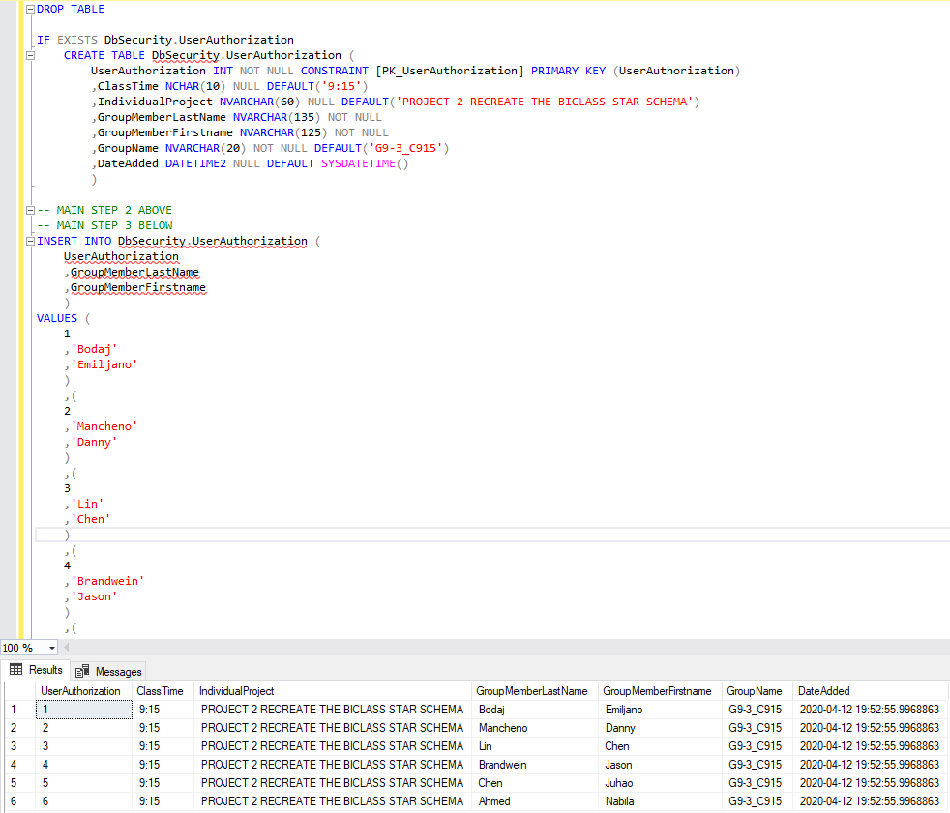
Creating the DbSecurity.UserAuthorization table and inserting the
group’s information into it
Each UserAuthorization
Number refers to a different team member
i.e.
1 = Emiljano Bodaj

Slide 12
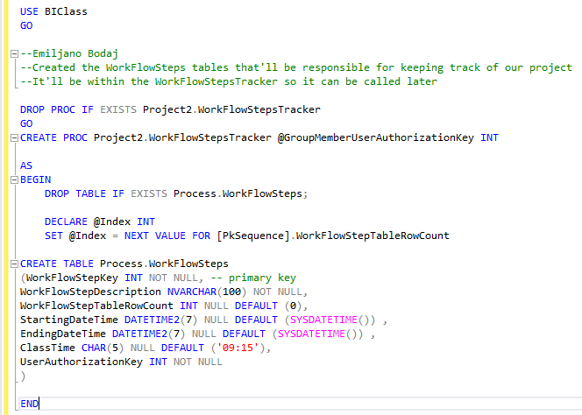
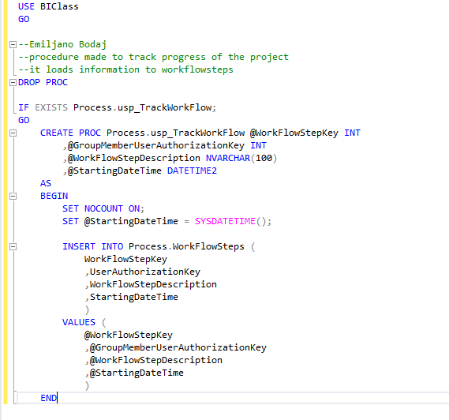
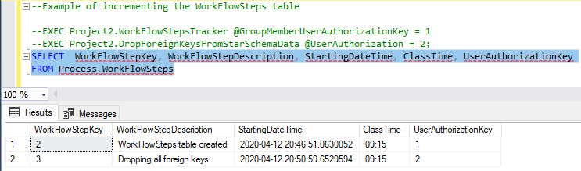
Creating the Project2.WorkFlowSteps table and Process.usp_TrackWorkFlow proc

Slide 13
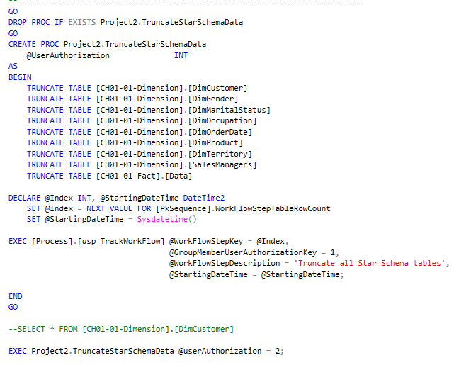
Truncating the data from the old tables and then recording this action into the
WorkFlowSteps table

Slide 14
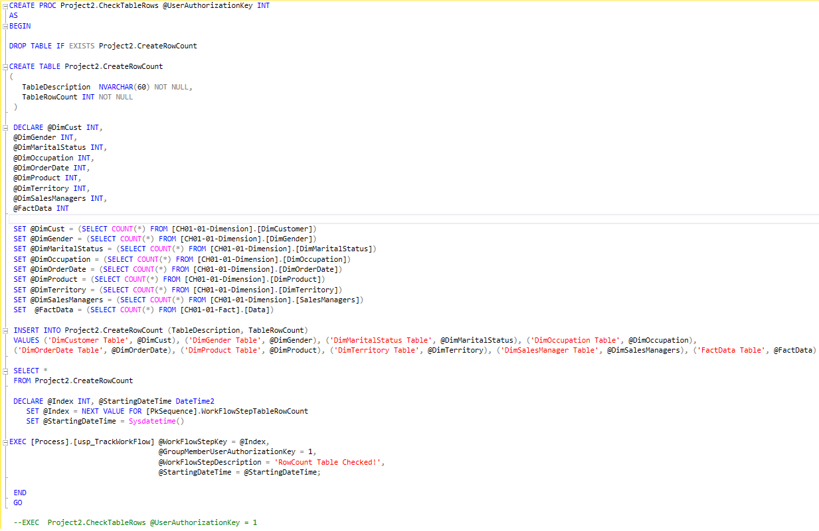
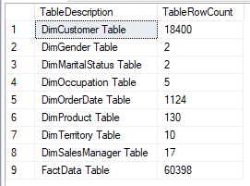
Project2.CheckTableRows proc makes a fresh table that is then inserted with the row count in
each individual table and displays said table, as well as updates the WorkFlowSteps table

